Slide 1



Selected aspects of manufacturing and testing of multilayer Al-Ti materials with enhanced ballistic resistance for areonautic and space constructions
Aleksander Gałka¹, Krzysztof Gałka¹, Fabian Żok¹, Piotr Bazarnik²
¹ Zakład Technologii Wysokoenergetycznych „Explomet”
²Politechnika Warszawska

Slide 2



New advanced layer Al-Ti materials with enhanced ballistic resistance for aeronautic and space constructions
Aluminum 2519/ Titanium Grade 5
Overview
Both are perfect construction materials (high endurance and low density)
Combining them can give interesting results
Clad materials will be tested in various aspects
  Microstructure
  Mechanical
  Fatigue
  Ballistic resistance
Umowa nr PBS2/A5/35/2013 z dn.24.10.2013, realizacja zadania nr 4
Notes:
Podtytuł: W realizacji…

Slide 3
New advanced layer Al-Ti materials with enhanced ballistic resistance for aeronautic and space constructions
Test Plan
Manufacture sample clad plates in following sizes
  (3 + 3) x 300 x 500mm
  (5 + 5) x 300 x 500mm
  (10 + 10) x 300 x 500mm
In following bonding varieties
  Direct bonding Ti6Al4V/2519
  Bonding Ti6Al4V/2519 with 1mm Al1050 interlayer
  Bonding Ti6Al4V/2519 with 0,8mm TiGr2 interlayer
Umowa nr PBS2/A5/35/2013 z dn.24.10.2013, realizacja zadania nr 4
Notes:
Podtytuł: W realizacji…

Slide 4
New advanced layer Al-Ti materials with enhanced ballistic resistance for aeronautic and space constructions
Explosive Material Selection
Detonation velocity measurement in various thicknesses
Selection criterias:
  stable course of the detonation in the usable layer
  appropriate level of initiation sensitivity
  appropriate resistance to atmospheric conditions, especially satisfactory hydrophobic properties
  low manufacturing cost
  maximal usability safety
Chemical composition[%] | Composition name
 | Saletrol B | Saletrol C | Saletrol B1 | Saletrol C1
Amonium Nitrate | 76 | 76 | 79,2 | 79,2
Sodium chloride | 20 | 0 | 20 | 0
Mineral inert | 0 | 20 | 0 | 20
Fuel oil | 4 | 4 | 0,8 | 0,8
Umowa nr PBS2/A5/35/2013 z dn.24.10.2013, realizacja zadania nr 4
Notes:
Podtytuł: W realizacji…

Slide 5
New advanced layer Al-Ti materials with enhanced ballistic resistance for aeronautic and space constructions
Explosive Material Selection
Detonation velocity measurement results
Explosive material height H[mm] | Detonation velocity D [m/s]
 | Saletrol B | Saletrol C | Saletrol B1 | Saletrol C1
30 | 2065 | 1980 | 1832 | 1809
50 | 2390 | 2286 | 2050 | 1910
Umowa nr PBS2/A5/35/2013 z dn.24.10.2013, realizacja zadania nr 4
Notes:
Podtytuł: W realizacji…

Slide 6
New advanced layer Al-Ti materials with enhanced ballistic resistance for aeronautic and space constructions
Manufactured Sample Plates
Performed tests
Ultrasonic examination of the bonding zone
Mechanical endurance examination consisting of sheer, tensile and bend tests
Micro hardness measurement
Microstructure assessment
Umowa nr PBS2/A5/35/2013 z dn.24.10.2013, realizacja zadania nr 4
Notes:
Podtytuł: W realizacji…

Slide 7
New advanced layer Al-Ti materials with enhanced ballistic resistance for aeronautic and space constructions
Manufactured Sample Plates
including bonding parameters
Sample number | Setup | Explosive | H[mm] | D[m/s] | Vp[m/s]
32A | 3+1+3 2519/1050/TiGr5 | Saletrol B | 30 | 2065 | 644
35A | 3+1+3 2519/1050/TiGr5 | Saletrol B | 30 | 2065 | 690
35T | 3+0,8+3 2519/TiGr2/TiGr5 | Saletrol B | 30 | 2065 | 690
53A | 5+1+5 2519/1050/TiGr5 | Saletrol B1 | 50 | 2050 | 670
55A | 5+1+5 2519/1050/TiGr5 | Saletrol B1 | 50 | 2050 | 808
55T | 5+0,8+5 2519/TiGr2/TiGr5 | Saletrol B1 | 50 | 2050 | 808
56 | 5+5 2519/TiGr5 | Saletrol C1 | 50 | 1910 | 640
Umowa nr PBS2/A5/35/2013 z dn.24.10.2013, realizacja zadania nr 4
Notes:
Podtytuł: W realizacji…

Slide 8
New advanced layer Al-Ti materials with enhanced ballistic resistance for aeronautic and space constructions
Heat Treatment
HT1 - Annealing in 530 deg. C for 0,5 hours and cooling in air (C signing)
HT2 - Annealing in 530 deg. C for 0,5 hours and cooling in water, ageing in 150 deg. C for 10 hours, cold rolling with 15% mechanical reduction of the Al layer (signing C1)
HT3 – Annealing in 530 deg. C for 0,5 hours and cooling in water
HT4 - Annealing in 420 deg. C for 1 hour, cooling in air (signing C2).
Umowa nr PBS2/A5/35/2013 z dn.24.10.2013, realizacja zadania nr 4
Notes:
Czerwony bez OC

Slide 9
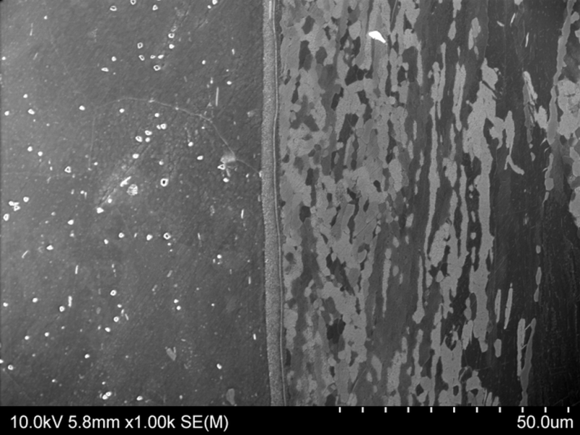
New advanced layer Al-Ti materials with enhanced ballistic resistance for aeronautic and space constructions
Microstructural Test Assessment
Sample plate 32A with Al1050 interlayer – SEM image
Intermetallic layer
Al
1050
Ti Gr5
Umowa nr PBS2/A5/35/2013 z dn.24.10.2013, realizacja zadania nr 4
Notes:
Podtytuł: W realizacji…

Slide 10
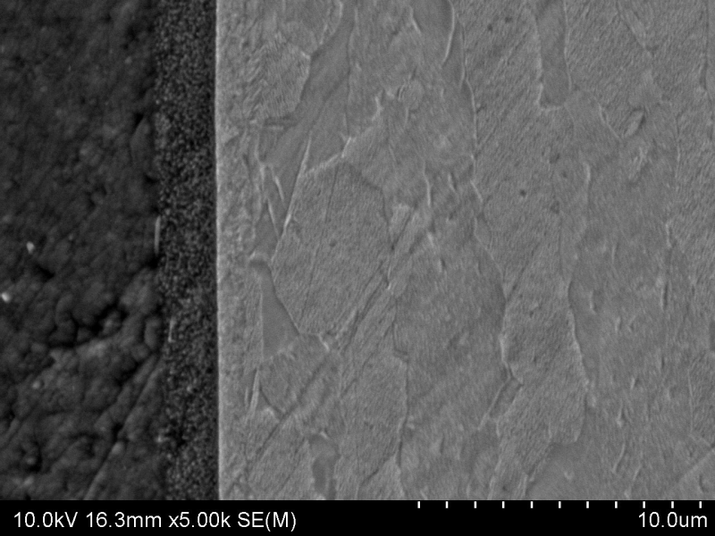
New advanced layer Al-Ti materials with enhanced ballistic resistance for aeronautic and space constructions
Microstructural Test Assessment
Sample plate 32A with Al1050 interlayer – SEM (BSE) image
Al1050
Ti Gr5
Intermetallic layer
Umowa nr PBS2/A5/35/2013 z dn.24.10.2013, realizacja zadania nr 4
Notes:
Podtytuł: W realizacji…

Slide 11
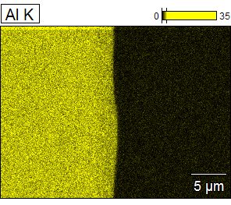
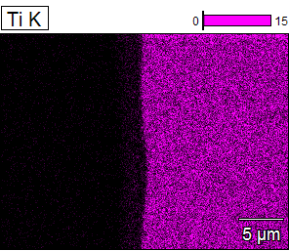
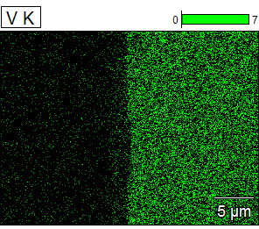
New advanced layer Al-Ti materials with enhanced ballistic resistance for aeronautic and space constructions
Microstructural Test Assessment
Intermetallic layer (2519/1050) visible in EDX spectrum
Intermetallic layer
1 – 10 um
Umowa nr PBS2/A5/35/2013 z dn.24.10.2013, realizacja zadania nr 4

Slide 12
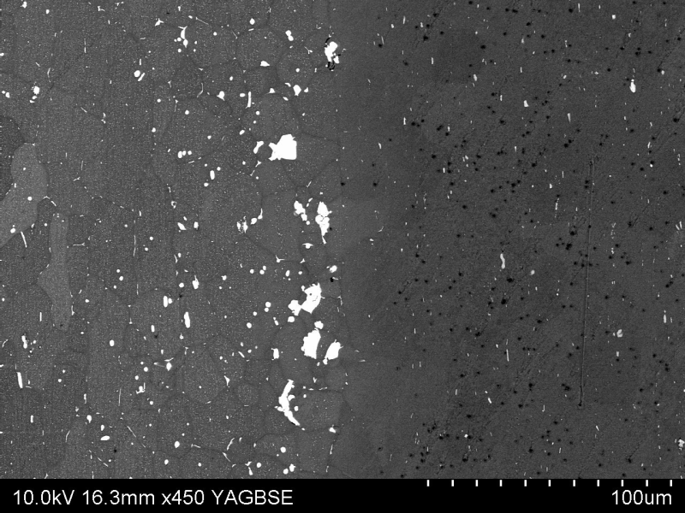
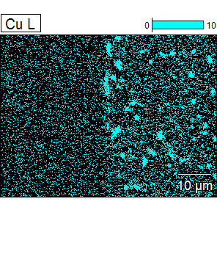
New advanced layer Al-Ti materials with enhanced ballistic resistance for aeronautic and space constructions
Microstructural Test Assessment
Sample plates with Al1050 interlayer
Al 2519
Al 1050
Al 2519
BSE image and EDX spectrum. Copper emmision on the 2519 side on the boarder of the 2519/1050 bond. No intermetallic layer was present.
Umowa nr PBS2/A5/35/2013 z dn.24.10.2013, realizacja zadania nr 4
Notes:
Podtytuł: W realizacji…

Slide 13
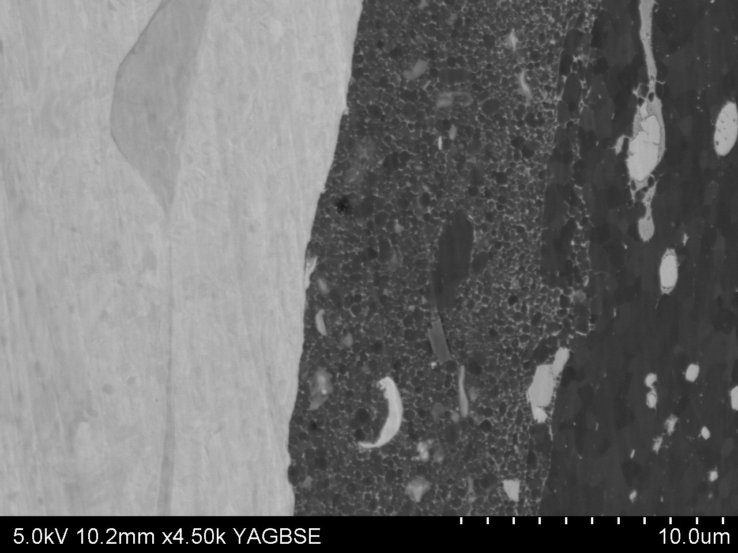
New advanced layer Al-Ti materials with enhanced ballistic resistance for aeronautic and space constructions
Microstructural Test Assessment
Sample 56 - direct bonding TiGr5/Al2519
Ti Gr5
Al
2519
TiGr5/Al2519 bond zone. No intermetallic phase found. Regular network of copper emissions found on the 2519 side.
Umowa nr PBS2/A5/35/2013 z dn.24.10.2013, realizacja zadania nr 4
Notes:
Podtytuł: W realizacji…

Slide 14
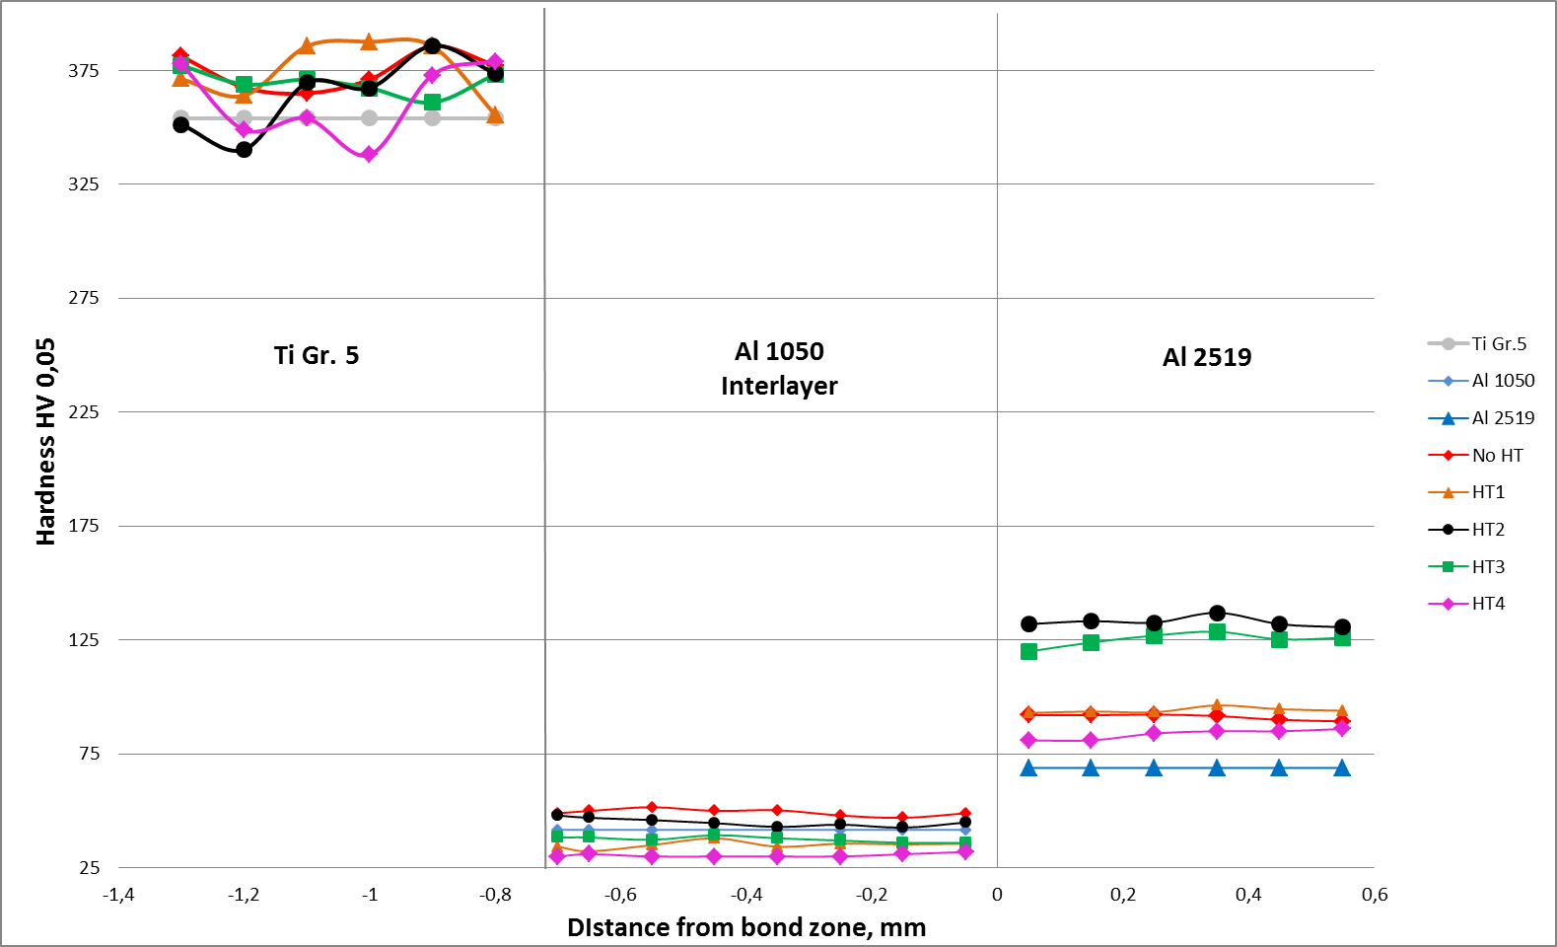
New advanced layer Al-Ti materials with enhanced ballistic resistance for aeronautic and space constructions
Microhardness And Endurance Tests
Sample 32A
Author: Michał Najwer, Opole University of Technology
Umowa nr PBS2/A5/35/2013 z dn.24.10.2013, realizacja zadania nr 4
Notes:
Podtytuł: W realizacji…

Slide 15
New advanced layer Al-Ti materials with enhanced ballistic resistance for aeronautic and space constructions
Microhardness And Endurance Tests
Observations
Applied heat treatment does not influence hardening of titanium.
Significant hardness reduction of Al1050 in each heat treatment scenario.
Rise of Al2519 hardness.
Best hardening achieved by thermomechanic processing due to long material cooling times/ ageing and material deformation during cold rolling and emission processes (copper) in the bond zone.
Umowa nr PBS2/A5/35/2013 z dn.24.10.2013, realizacja zadania nr 4
Notes:
Podtytuł: W realizacji…

Slide 16
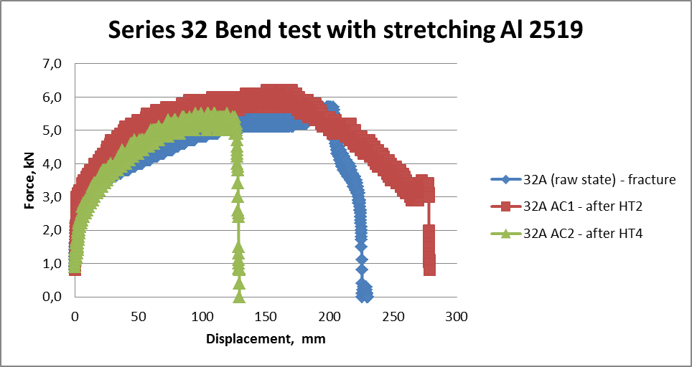
New advanced layer Al-Ti materials with enhanced ballistic resistance for aeronautic and space constructions
Mechanical Testing
Umowa nr PBS2/A5/35/2013 z dn.24.10.2013, realizacja zadania nr 4
Notes:
32A bend test
Wywalić Al. – dopisać after cladding/HT

Slide 17
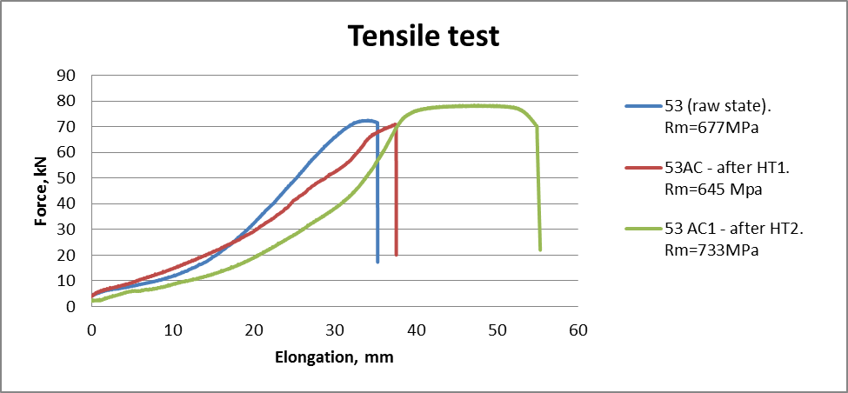
New advanced layer Al-Ti materials with enhanced ballistic resistance for aeronautic and space constructions
Mechanical Testing
Tensile test results. Thermomechanic processing resulted in 10% rise of endurance.
Umowa nr PBS2/A5/35/2013 z dn.24.10.2013, realizacja zadania nr 4
Notes:
Dopisać after cladding/HT

Slide 18
New advanced layer Al-Ti materials with enhanced ballistic resistance for aeronautic and space constructions
Mechanical Testing
Ram tensile test
Sample number | R₀[MPa] | Location of fracture
32A | 80 | 1050
35A | 76 | 1050/2519 joint
35T | 113 | TiGr2
55A | 185 | 1050
55T | 168 | TiGr2
56 | 156 | 2519
Umowa nr PBS2/A5/35/2013 z dn.24.10.2013, realizacja zadania nr 4
Notes:
Podtytuł: W realizacji…

Slide 19






New advanced layer Al-Ti materials with enhanced ballistic resistance for aeronautic and space constructions
Mechanical Testing
Energy absorption comparison (sample 55A/T)
Interlayer Al1050
$∆t=33°$
Al2519
Al1050
TiGr5
Al2519
Al1050
TiGr5
$$Heat energy accumulation E≈150kJ$$
Interlayer TiGr2
$∆t=47°$
Al2519
TiGr2
TiGr5
Al2519
TiGr2
TiGr5
$$Heat energy accumulation E≈200kJ$$
Difference in energy absorbed by the materials structure
$$∆E=50kJ$$
Umowa nr PBS2/A5/35/2013 z dn.24.10.2013, realizacja zadania nr 4
Notes:
Podtytuł: W realizacji…

Slide 20




xplomet
ZAKŁAD TECHNOLOGII WYSOKOENERGETYCZNYCH
EXPLOMET GAŁKA, SZULC SPÓŁKA JAWNA
THANK YOU FOR YOUR ATTENTION

